Slide 1
ZOMATO REVIEW ANALYSIS
TEAM MEMBERS:
Sandipan Majhi
Akshita W
K Sai Charan Reddy
Sheeba A

Slide 2
01
ADVANTAGES AND DISADVANTAGES
02
APPLICATIONS
TABLE OF CONTENTS
03
04
EVENTS
INTRODUCTION

Slide 3
01
INTRODUCTION

Slide 4
Sentiment Analysis
Sentiment analysis, is that field of study people's opinions, sentiments, evaluations, judgments, attitudes, and emotions towards entities such as products, services, tourism, movies, organizations, political issues, individuals, problems, events, topics, etc. It is a type of data mining that measures the inclination of people's opinions through natural language processing (NLP), computational linguistics and text analysis, which are used to extract and analyse subjective information from the Web, mostly social media and similar sources.

Slide 5
Purpose
Zomato is a site where someone can give a review of a restaurant, how the restaurant is and someone's opinion about the restaurant. Review on Zomato is still in the form of text and can be classified with positive, negative, or neutral with their ratings. Zomato doesn’t have an analysis of how users interact with the reviews and what words will indicate they like or not it. We need to extract the words in review and analysis it so we can know how users interact in Zomato and get customers satisfaction by their review.

Slide 6
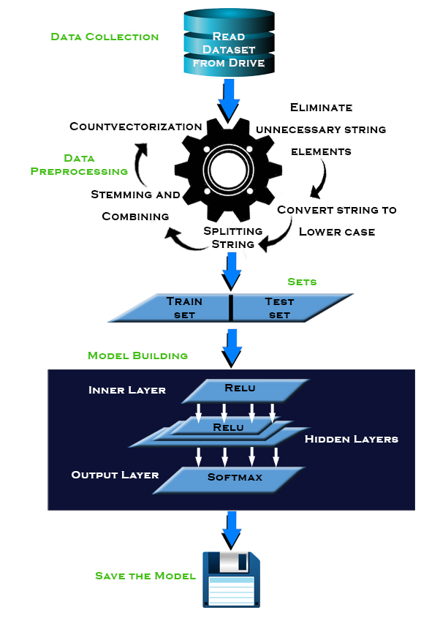
BLOCK DIAGRAM

Slide 7
02
ADVANTAGES AND DISADVANTAGES OF SENTIMENT ANALYSIS

Slide 8
ADVANTAGES
Saves time and energy that is wasted on searching for the best place to dine.
Saves overheads of comparing the ratings of each restaurant.
User friendly GUI helps people in easy analysis.
To develop more insightful, data-based marketing strategy.
To understand the customers.
In measuring marketing campaign.
Useful in boosting customer services.
Helps in better crisis management.

Slide 9
DISADVANTAGES
Implicit Sentiment and Sarcasm
A sentence may have an implicit sentiment even without the presence of any sentiment bearing words.
Implicit Sentiment and Sarcasm
There are many words whose polarity changes from domain to domain.

Slide 10
03
APPLICATIONS

Slide 11
APPLICATIONS OF SENTIMENT ANALYSIS
To identify spikes in sentiment, thereby allows identification of potential product advocates or social media influencers.
To identify potential customers.
Detecting antagonistic, heated language in mails, spam detection, context sensitive information detection etc.
Sentiment analysis in Social media like Twitter

Slide 12
04
USER INTERFACE

Slide 13
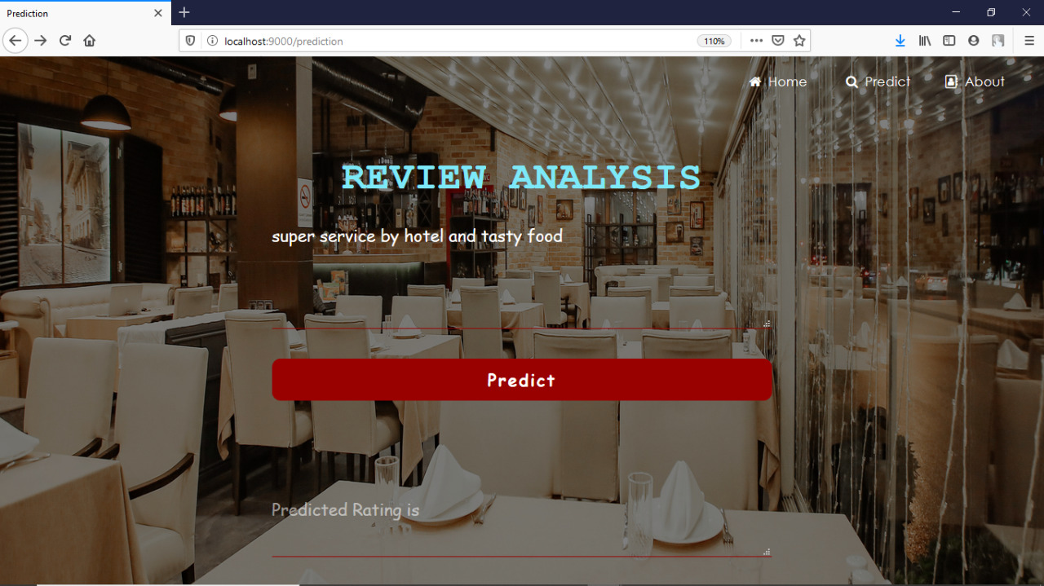
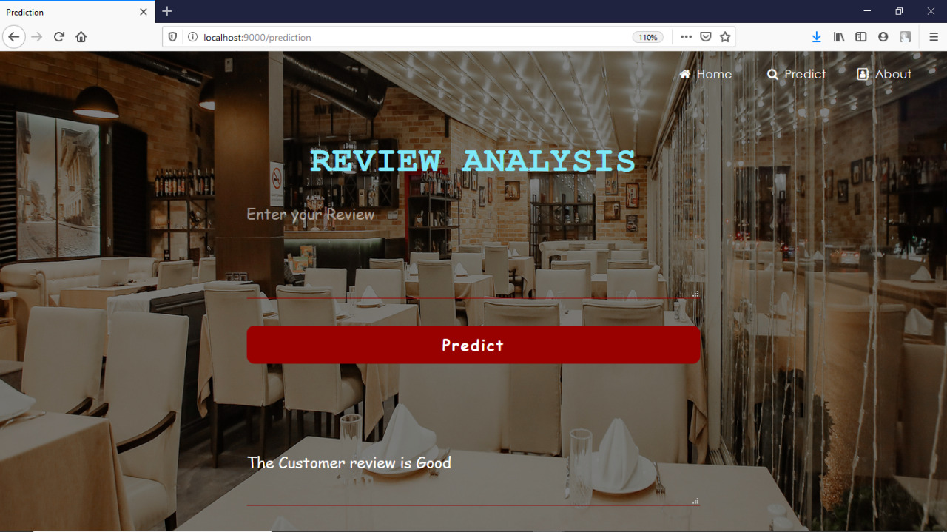
INPUT
OUTPUT

Slide 14
Thank You

